Slide 1
Diversity and change in Glasgow’s Social and Built Environment
Dr Jonathan Minton
AQMEN Research Fellow
University of Glasgow
Jonathan.Minton@Glasgow.ac.uk

Slide 2
Acknowledgements
Gwilym Pryce, AQMEN
Ade Kearns, GoWell

Slide 3
Some caveats/warnings
I tend to work from data to theory
I won’t try to ‘prove’ anything
And I will speculate.

Slide 4
Presentation Structure
Background
History of Greater Glasgow (GG)
Recent change in GG, rest of Scotland, rest of the UK
Theories
Urbanisation and suburbanisation
Network effects and functional geographies
Relationship between the physical, the social, and the economic
Methods
Diversity as entropy
Data and variables used
Definition of Greater Glasgow
Analyses performed
Results
Glasgow in Scottish context
Diversities within Glasgow
Discussion
Initial interpretations
Limitations
Further analyses

Slide 5
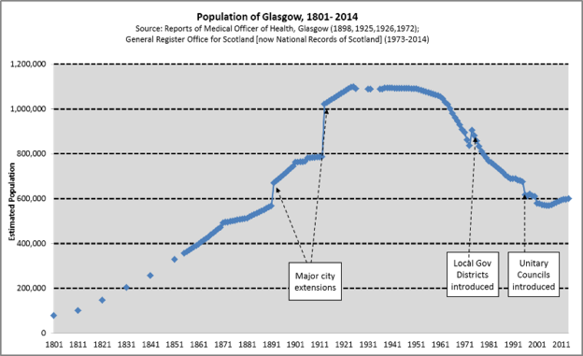
Background – History of Greater Glasgow
http://www.understandingglasgow.com/indicators/population/trends/historic_population_trend
https://en.wikipedia.org/wiki/Demography_of_Scotland

Slide 6
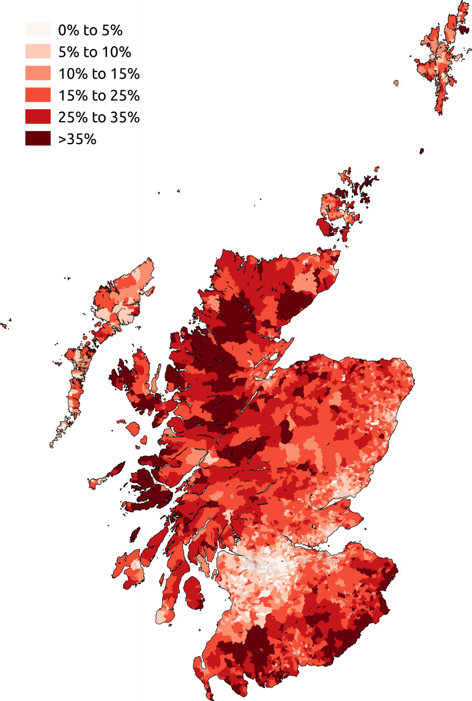
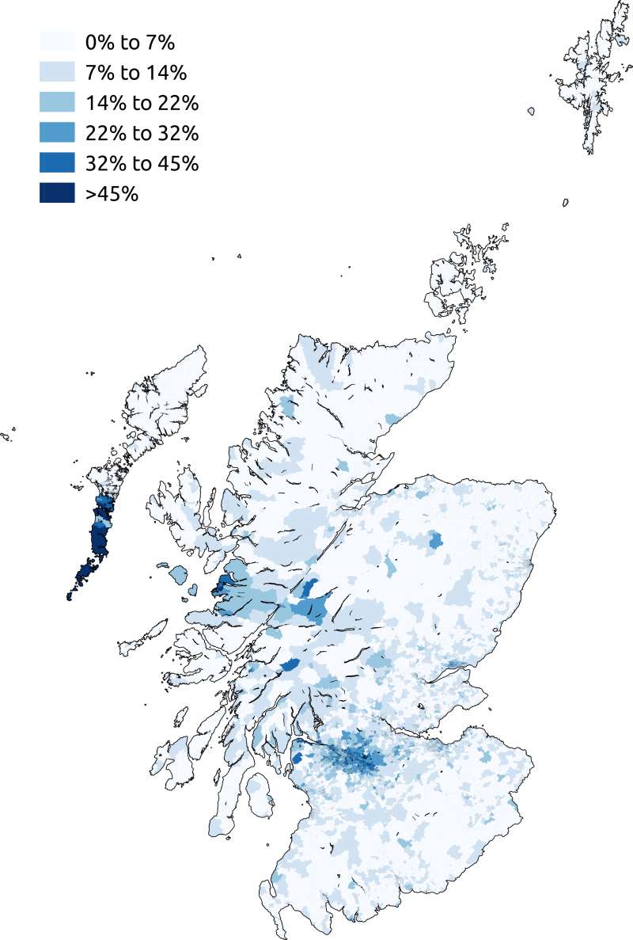
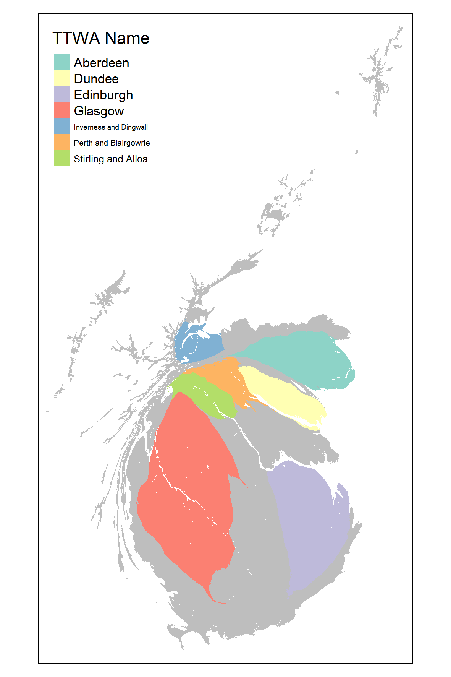
Background – Recent change in GG, rest of Scotland, rest of the UK
English
Born
Roman
Catholic
https://en.wikipedia.org/wiki/Demography_of_Scotland

Slide 7
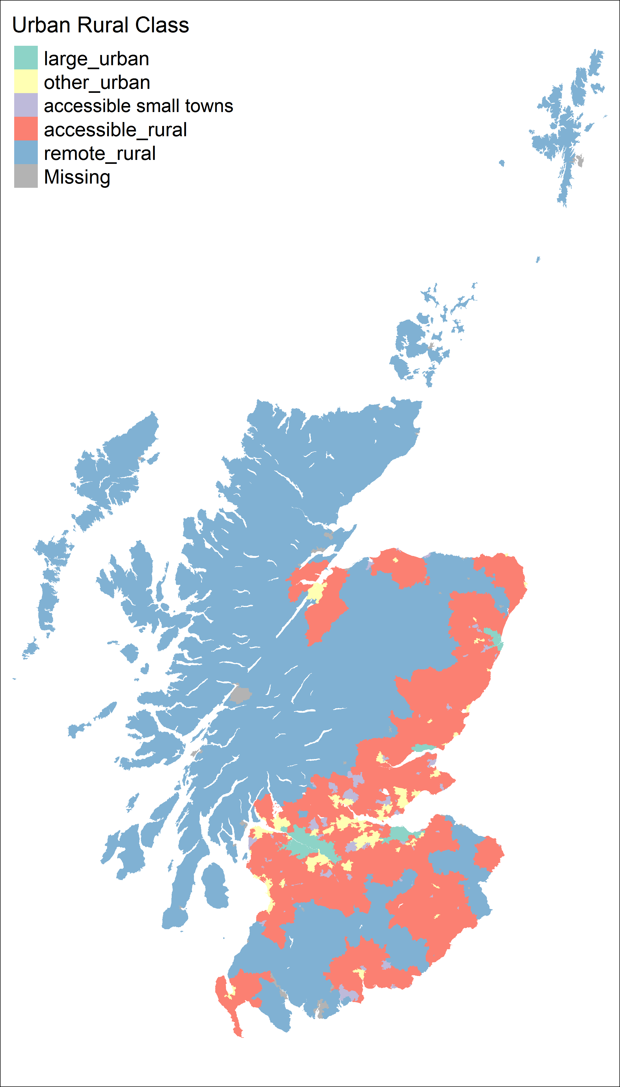
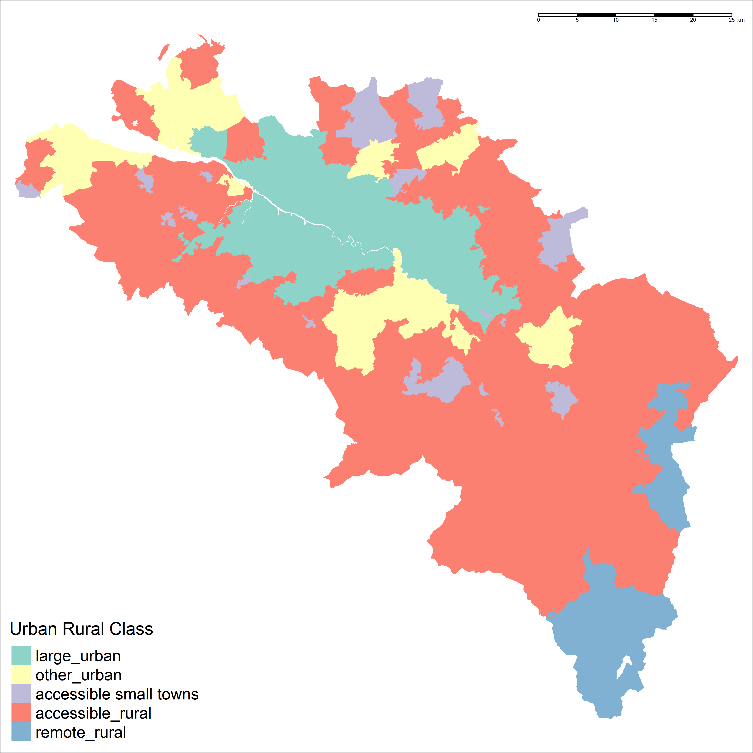
Theories – urbanisation and suburbanisation

Slide 8
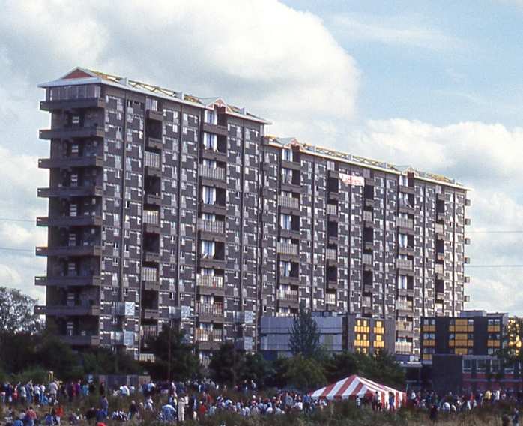
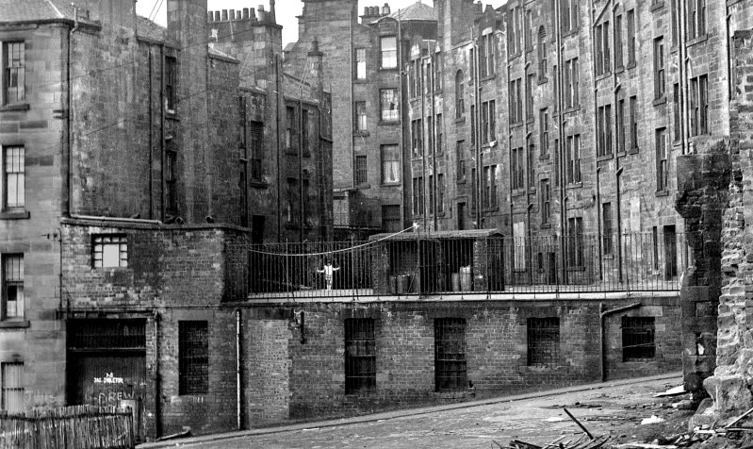
Theories – Housing and urban design
https://en.wikipedia.org/wiki/Hutchesontown_C
http://urbanglasgow.co.uk/archive/glasgow-in-the-1970s-clyde-to-townhead__o_t__t_1281.html

Slide 9
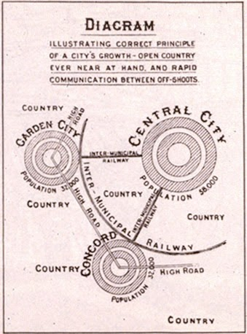
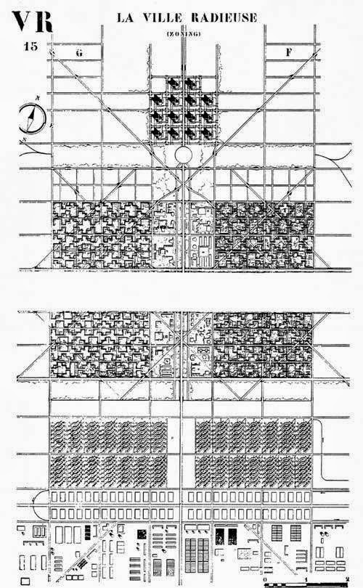
Theories – Housing and urban design
http://carissaevd-urbandesstudies.blogspot.co.uk/2013/10/history-of-urban-design-and-urban.html

Slide 10
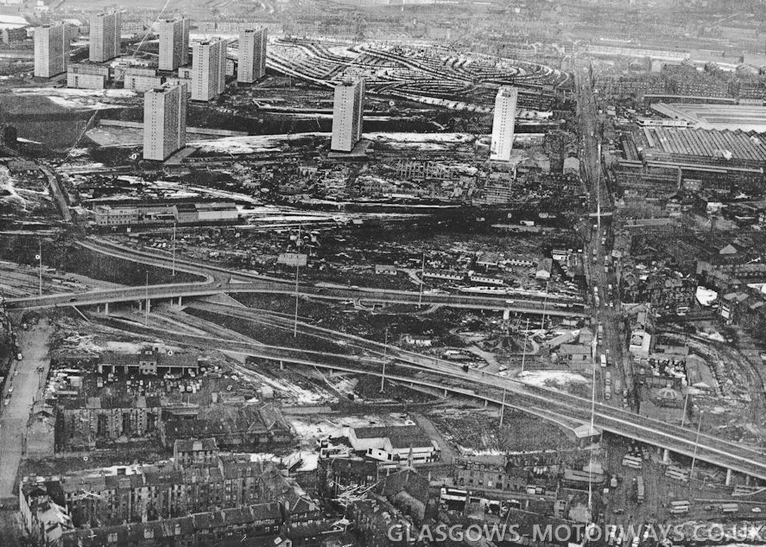
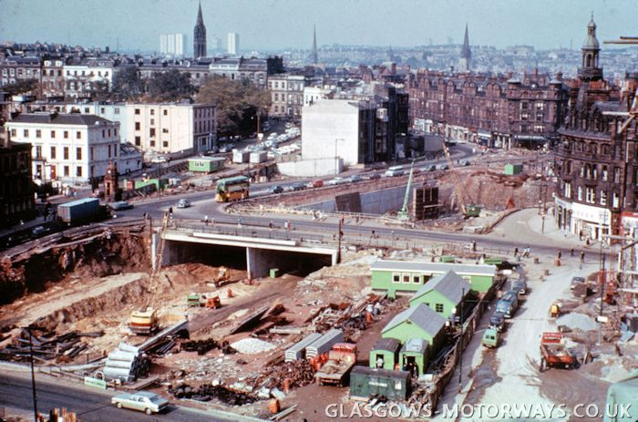
Theories – Housing and urban design
http://www.glasgows-motorways.co.uk/timeline/4591549029
http://www.glasgows-motorways.co.uk/the-m8-motorway/4588285335

Slide 11
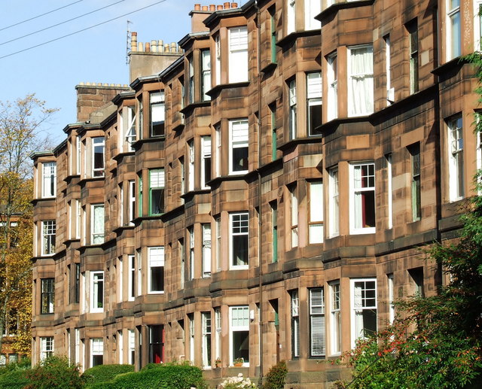
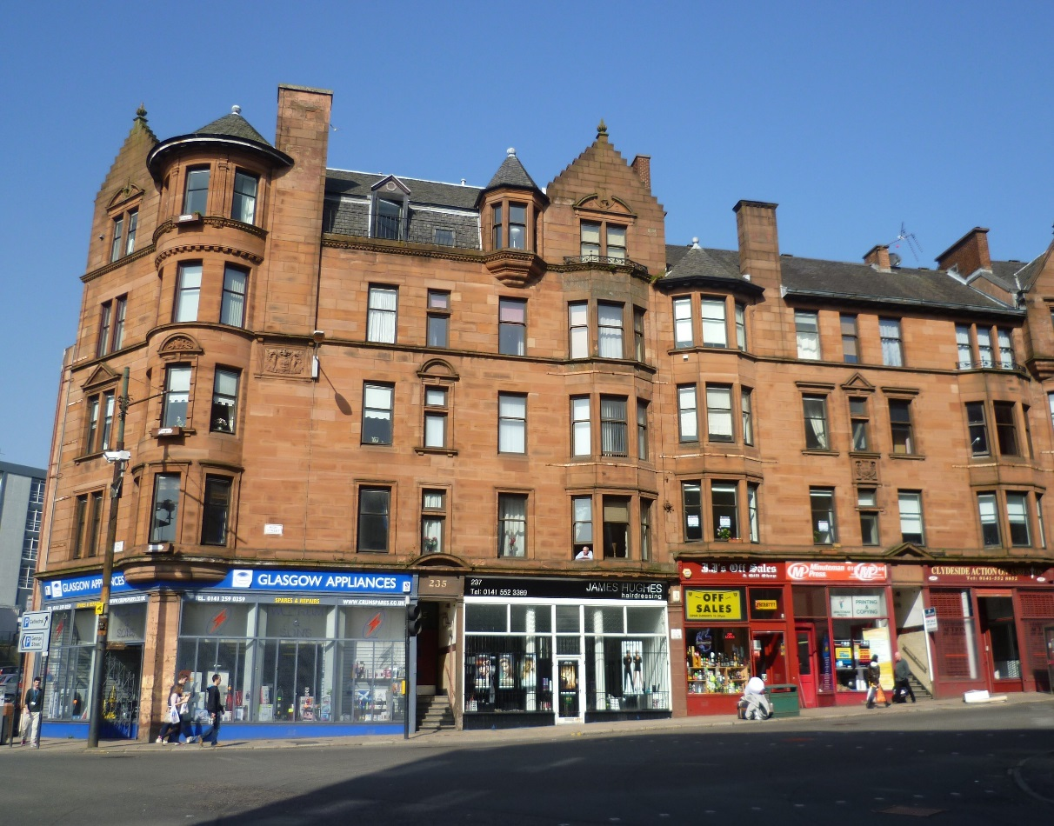
Theories – Housing and Urban Design
https://en.wikipedia.org/wiki/Housing_in_Glasgow
https://en.wikipedia.org/wiki/Housing_in_Glasgow
https://en.wikipedia.org/wiki/High_Street,_Glasgow

Slide 12
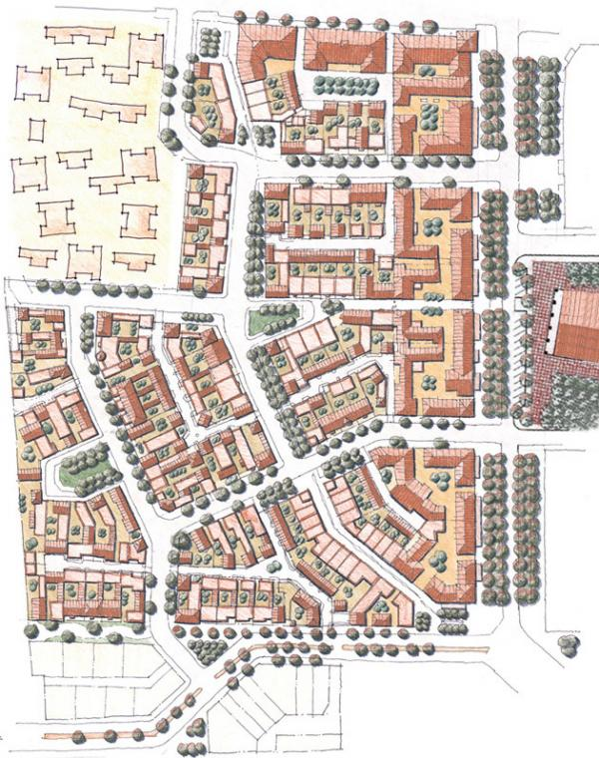
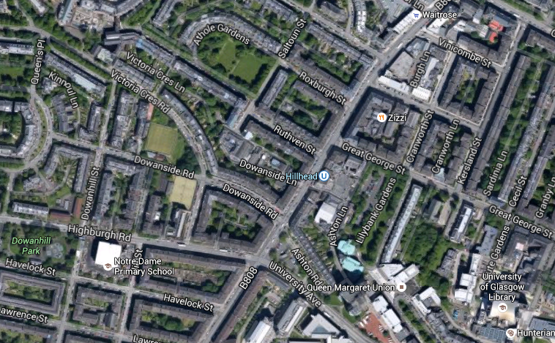
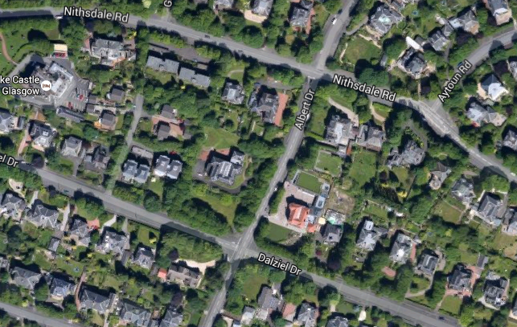
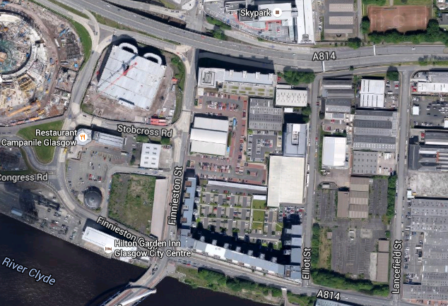
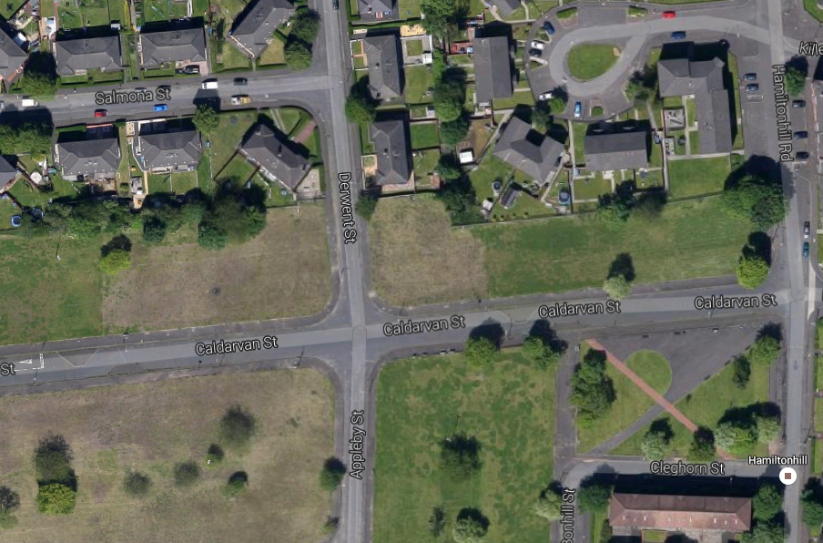
Theories – Housing and Urban Design
http://www.mparchitects.com/site/recognition/charter-award-1
https://www.google.co.uk/maps/@55.8668194,-4.2894789,15z

Slide 13
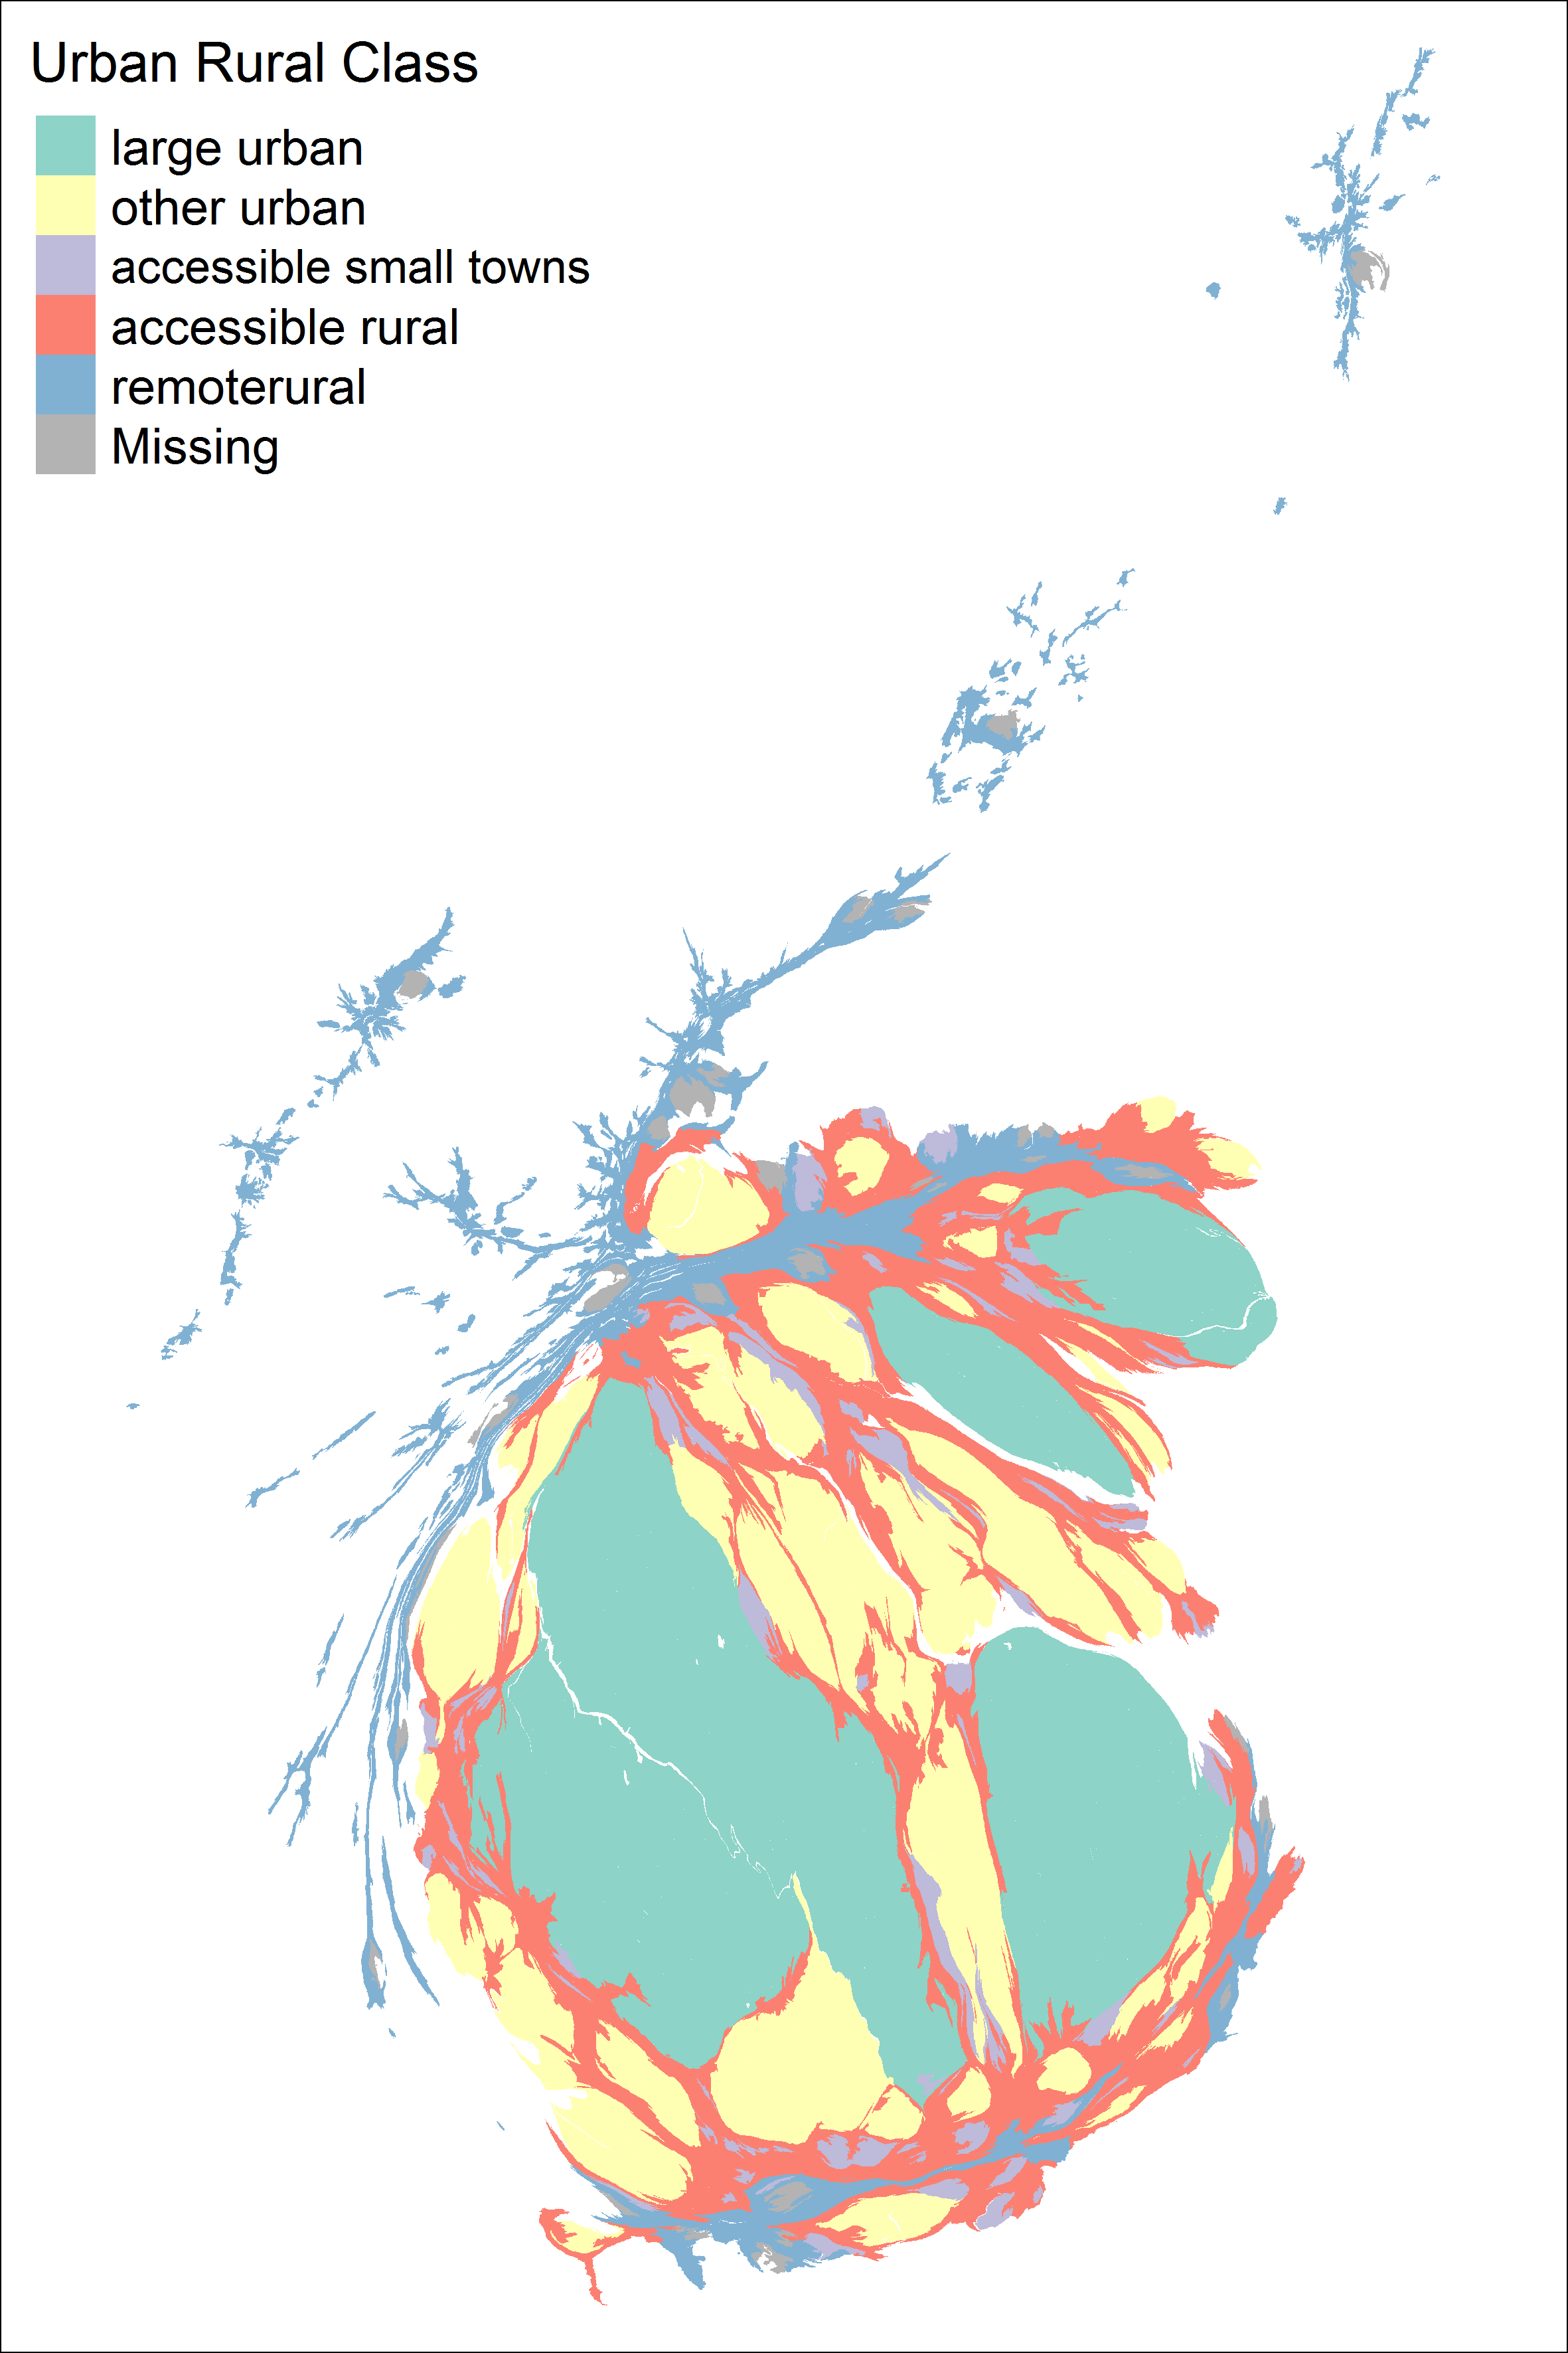
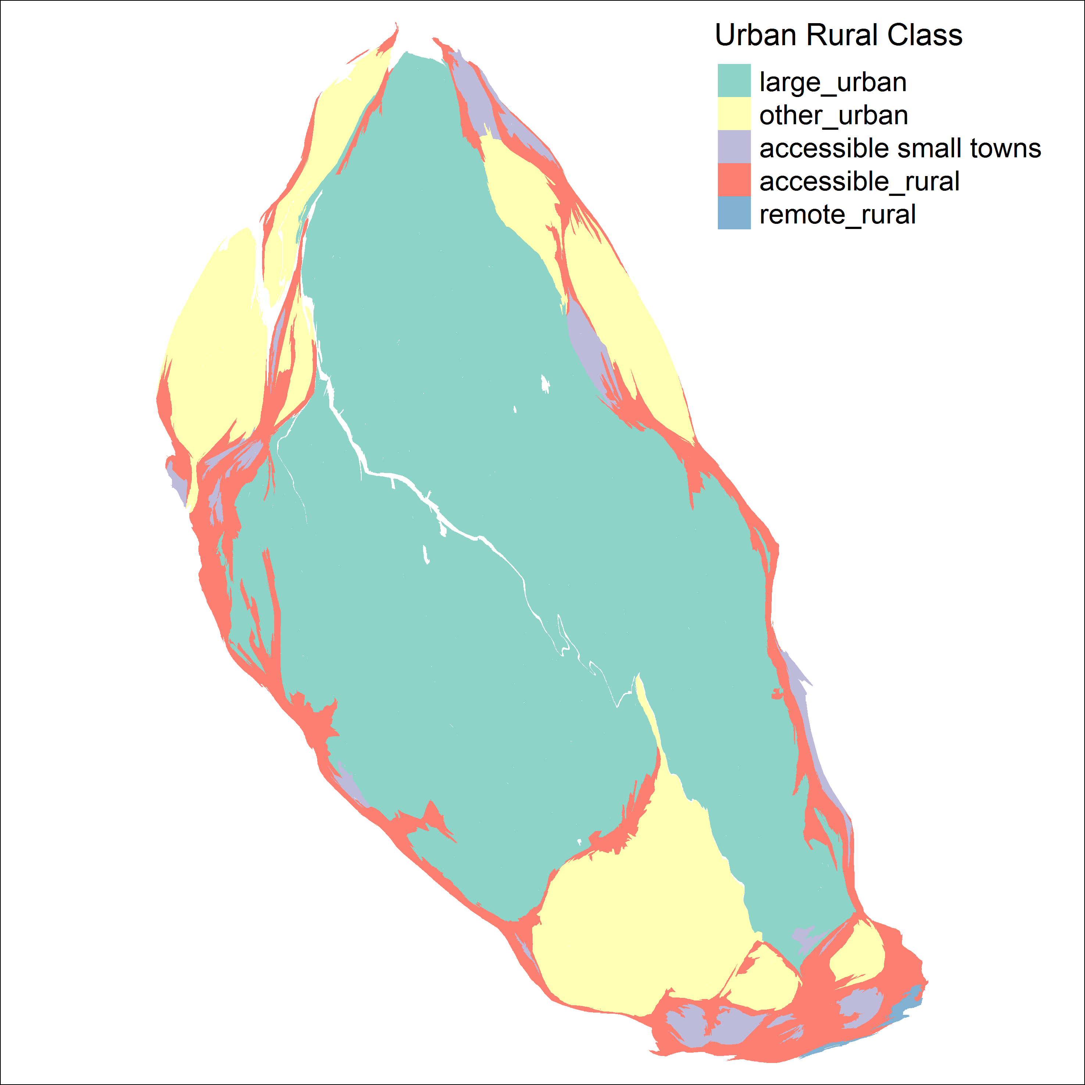
Theories – Network effects and functional geographies

Slide 14
Theories – Relationship between the physical, the social, and the economic
Ethnic Minority Proportions
Proportion of Households not owning a car

Slide 15
Theories – Relationship between the physical, the social, and the economic
Proportion not living in a house/bungalow
Proportion who are not married

Slide 16
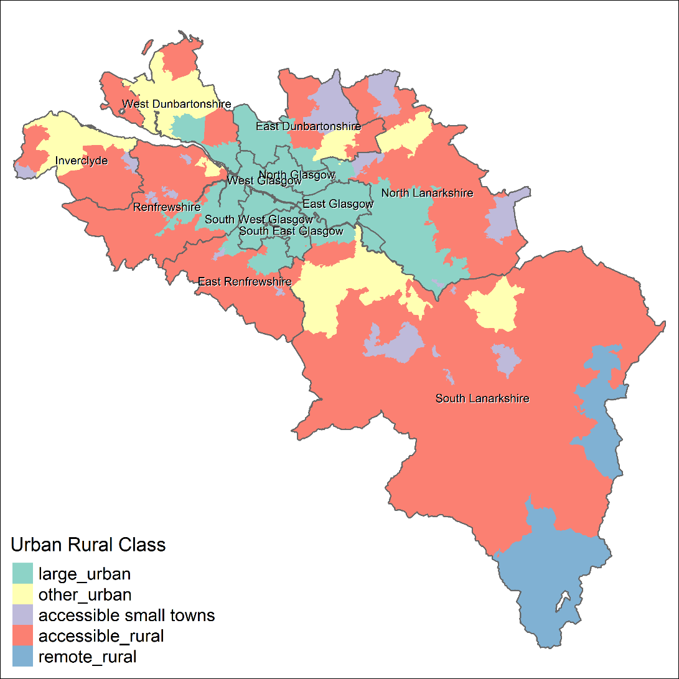
Methods – Definition of Greater Glasgow Used
12 Scottish Community Health Partnerships (CHPs)
(Link to Health & Wellbeing Survey?)

Slide 17
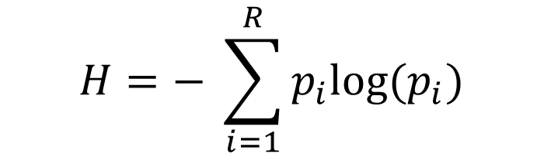
Methods – Diversity as entropy
Shannon’s Diversity Index H
Ecology and information theory
High segregation = low diversity
Values depend on R
Calculated for datazones (Scottish LSOAs)
$$H=− \sum_{i=1}^{R}{p_{i}log(p_{i})}$$
R : total number of groups
P_{i} : Proportion in area who are group i

Slide 18
Methods – Data and variables used
Data sources: 2001 and 2011 censuses (mainly)
Variable types:
Built environment
Council tax band
House size (number of bedrooms)
Type of building (house, flat etc)
Demographic:
Age structure (males, female, older, younger etc)
Country of origin (English, Scottish, non UK etc)
Religion (Catholic, Protestant, other Christian, Non-religious, other religion etc)
Economic:
Economic Activity status
Industry of employment
Highest educational qualification
Socioeconomic classification
Other:
Land use (occupied/vacant land parcels)
Tenure (Owned, rented, social rented)
Building use (residential only, business, mixed) – attempted from PAF but only for one year

Slide 19
Methods – Data and variables used
Grouping variables
Urban Rural Classification
Distance from city centre
Population density
Deprivation using SIMD
For each grouping variable, median H scores are calculated for 2001 and 2011

Slide 20
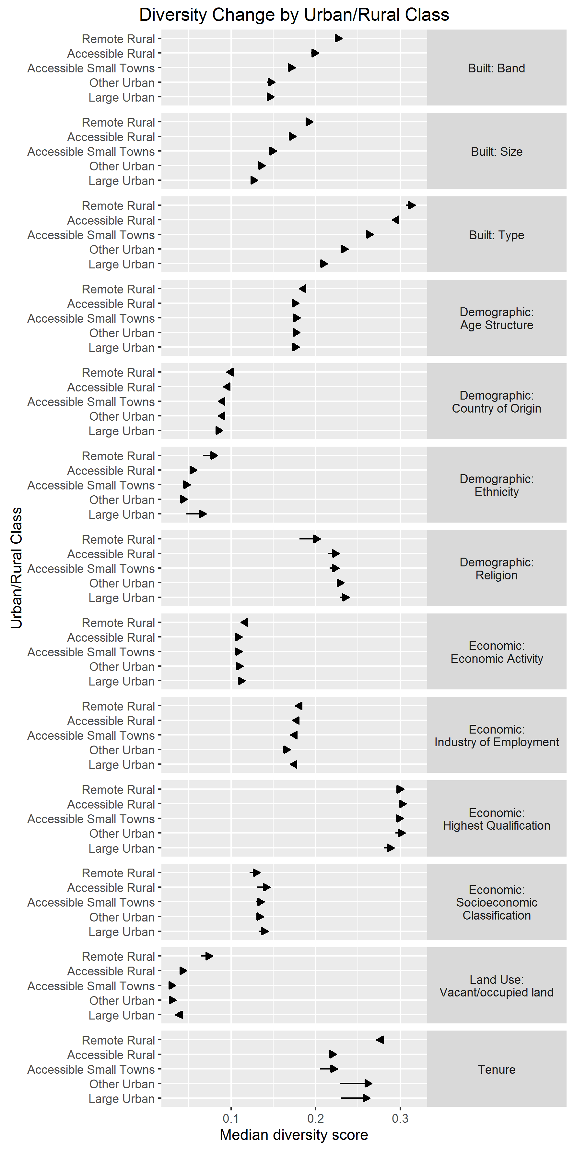
Results

Slide 21
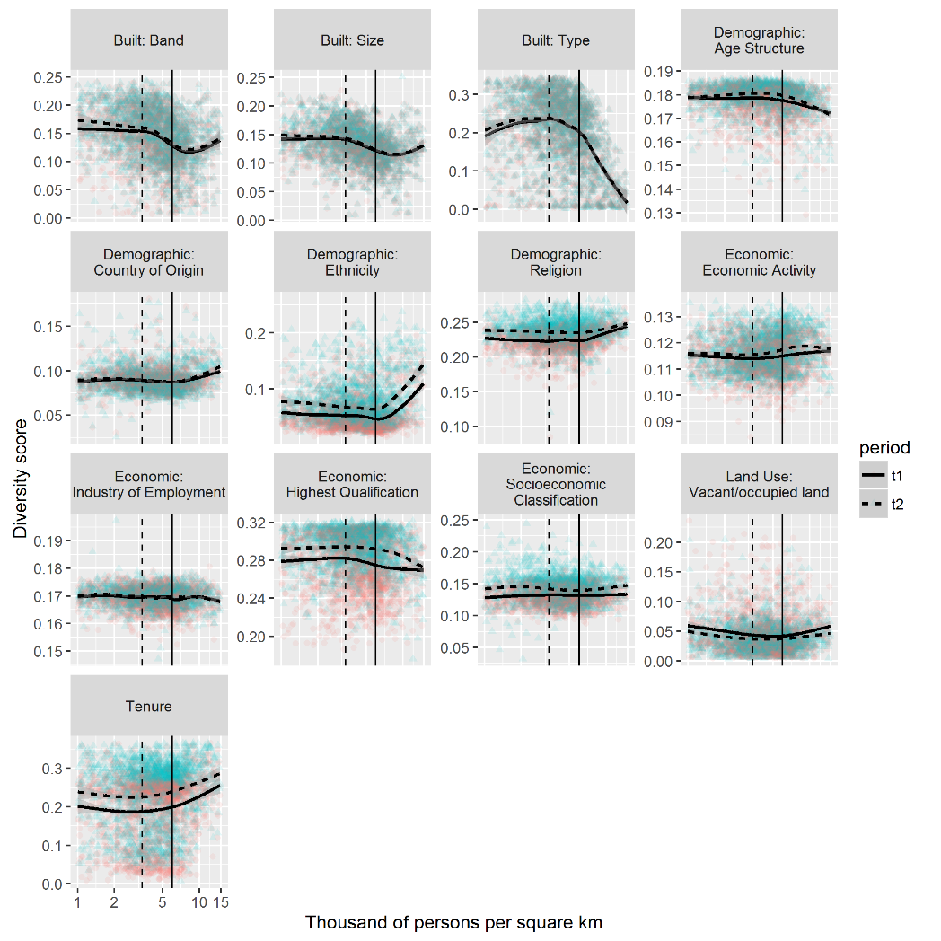
Results
Diversity by population density
Vertical dashed: 3.4k/km²
Greater Glasgow average
Vertical solid: 6.0k/km²
Ethnic, built, (tenure)

Slide 22
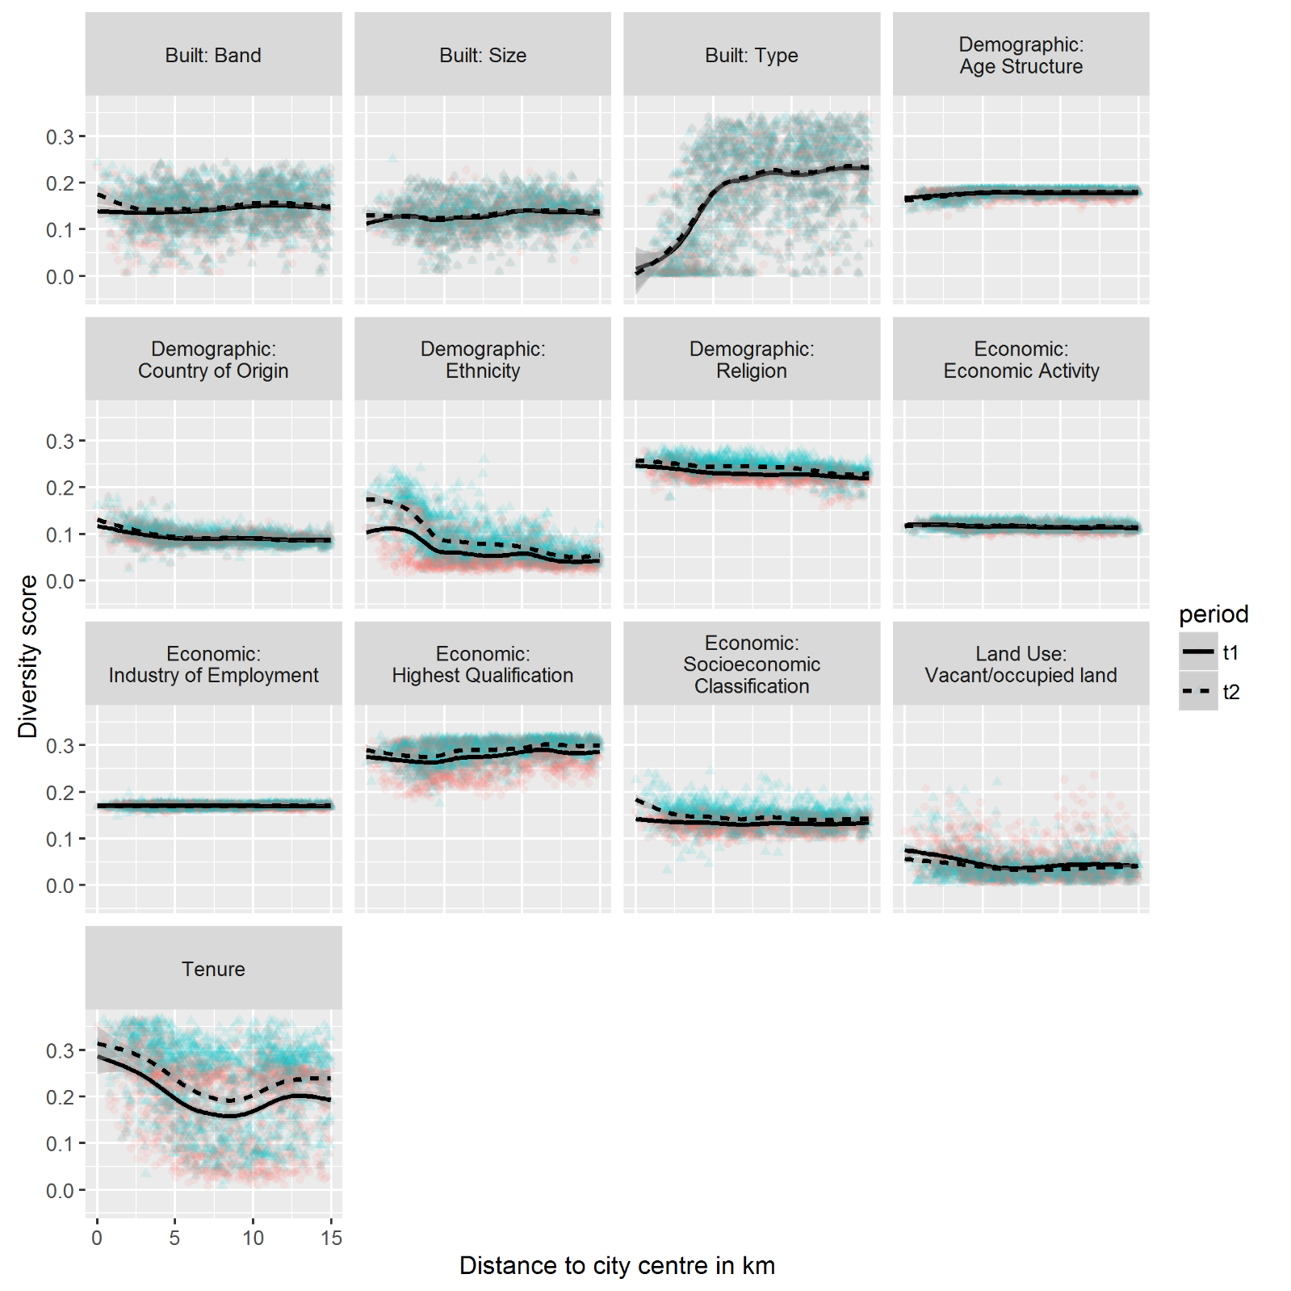
Results
Diversity by distance to city centre
Tenure, built, first 5-8 km

Slide 23
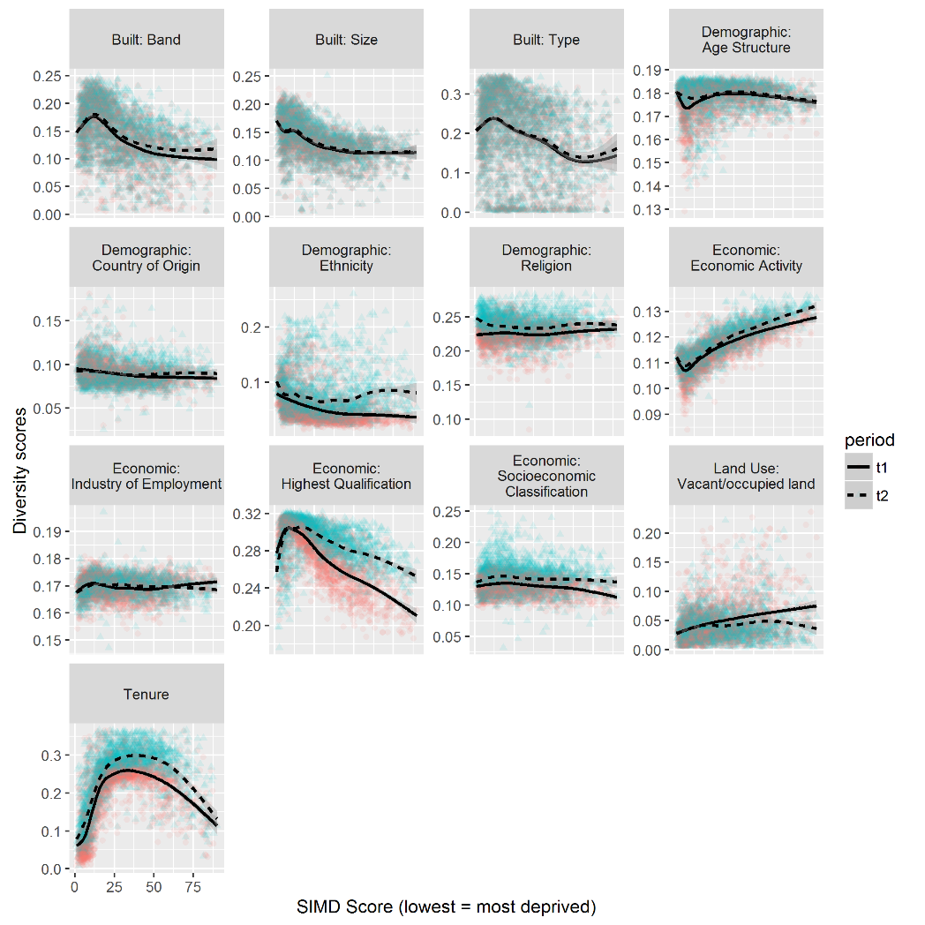
Results
Diversity by SIMD
Nonlinear relationships
Tendency to more diversity
Falling land use ‘diversity’
Ethnicity: Greatest increase in least deprived areas

Slide 24
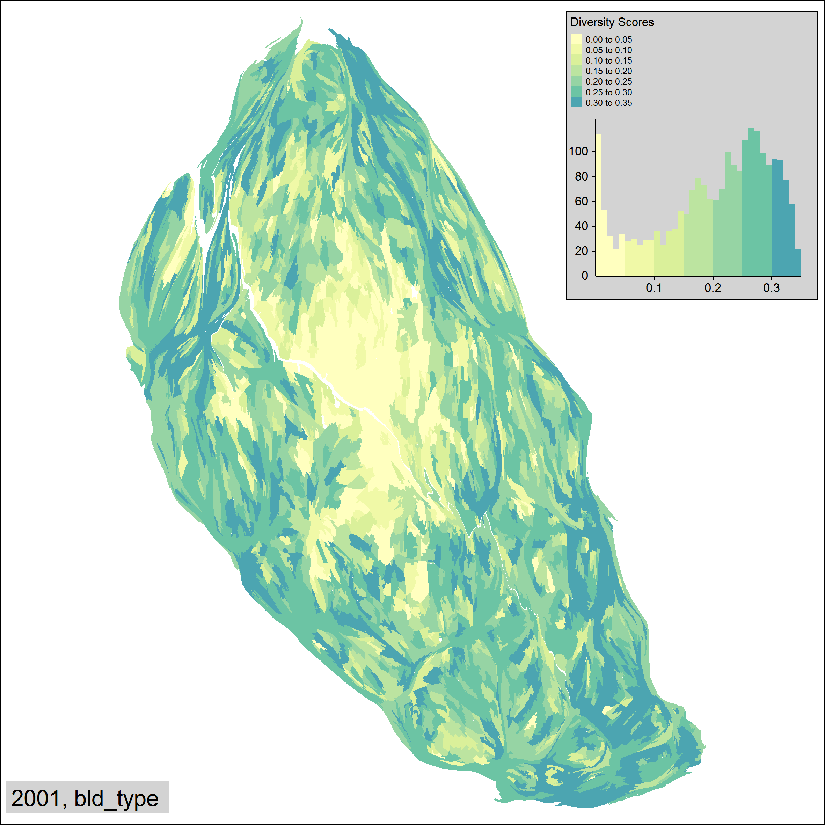
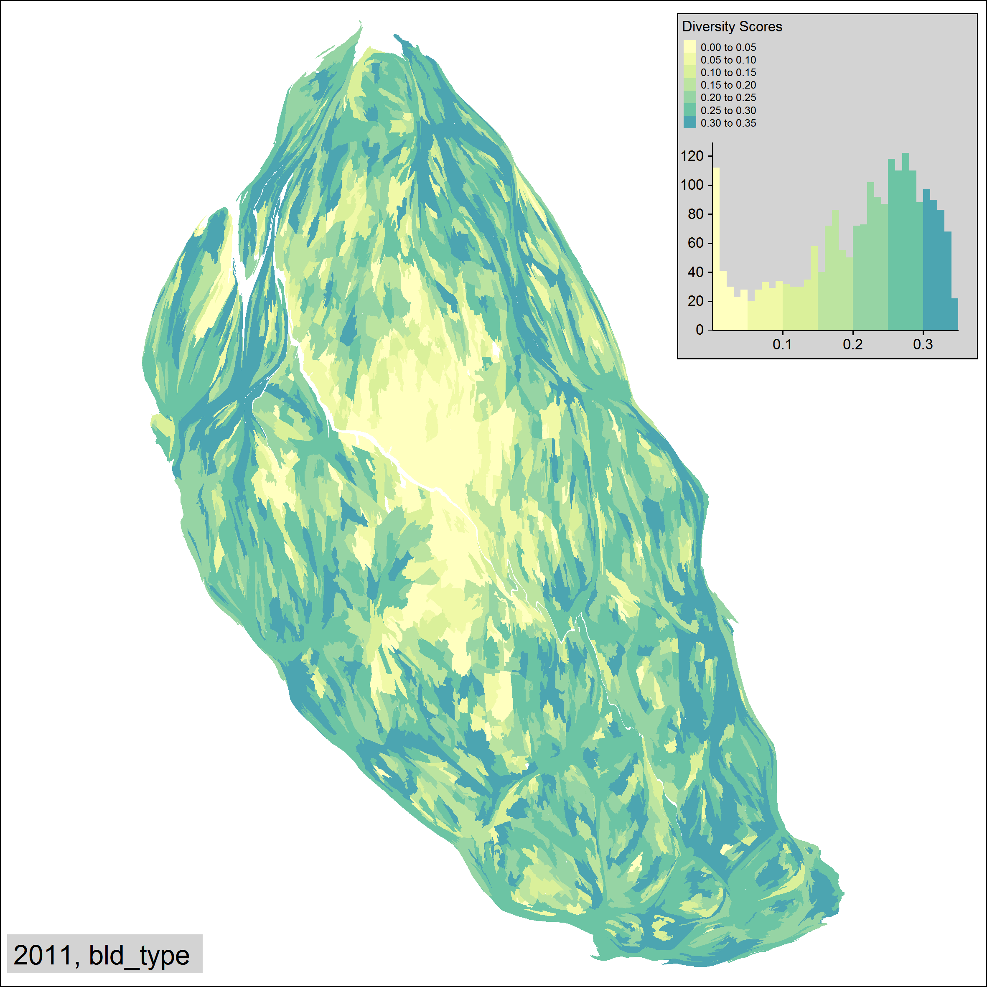
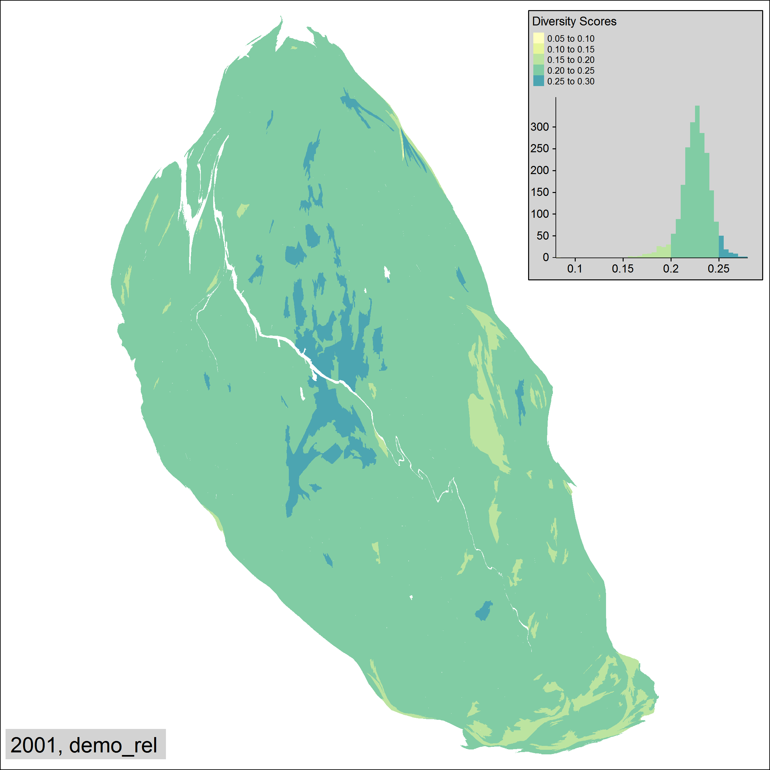
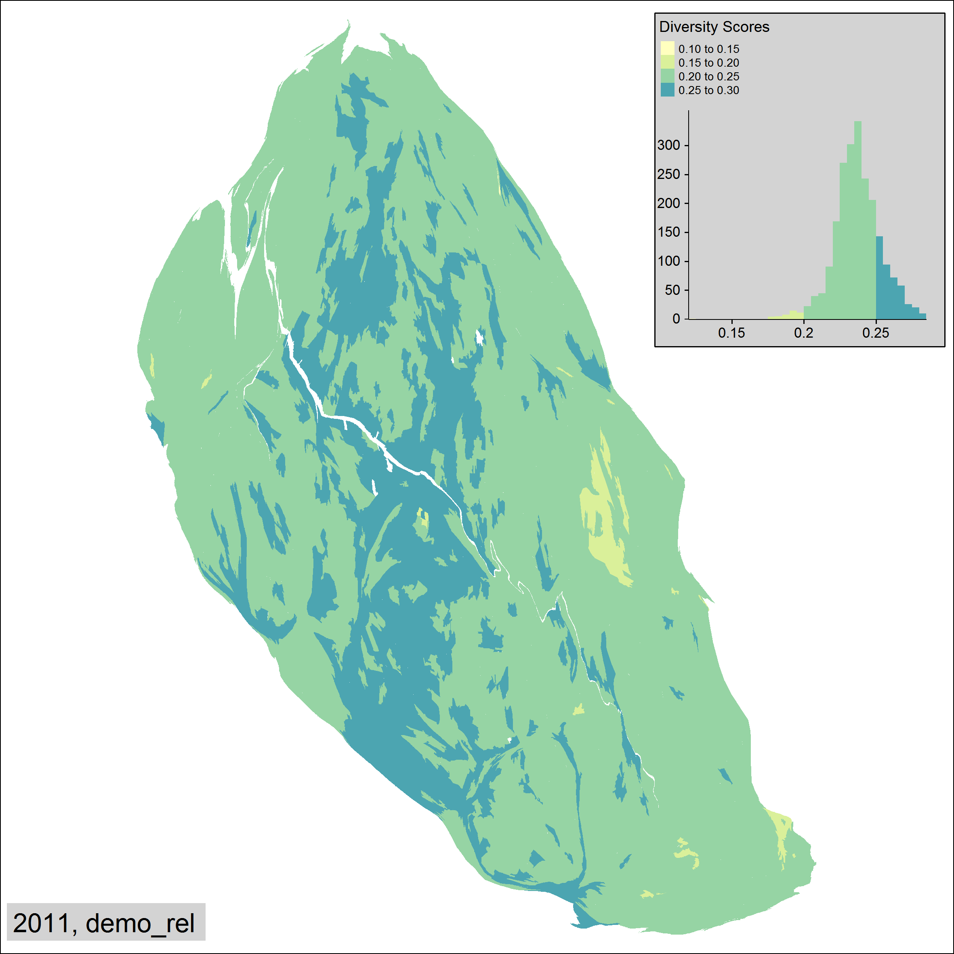
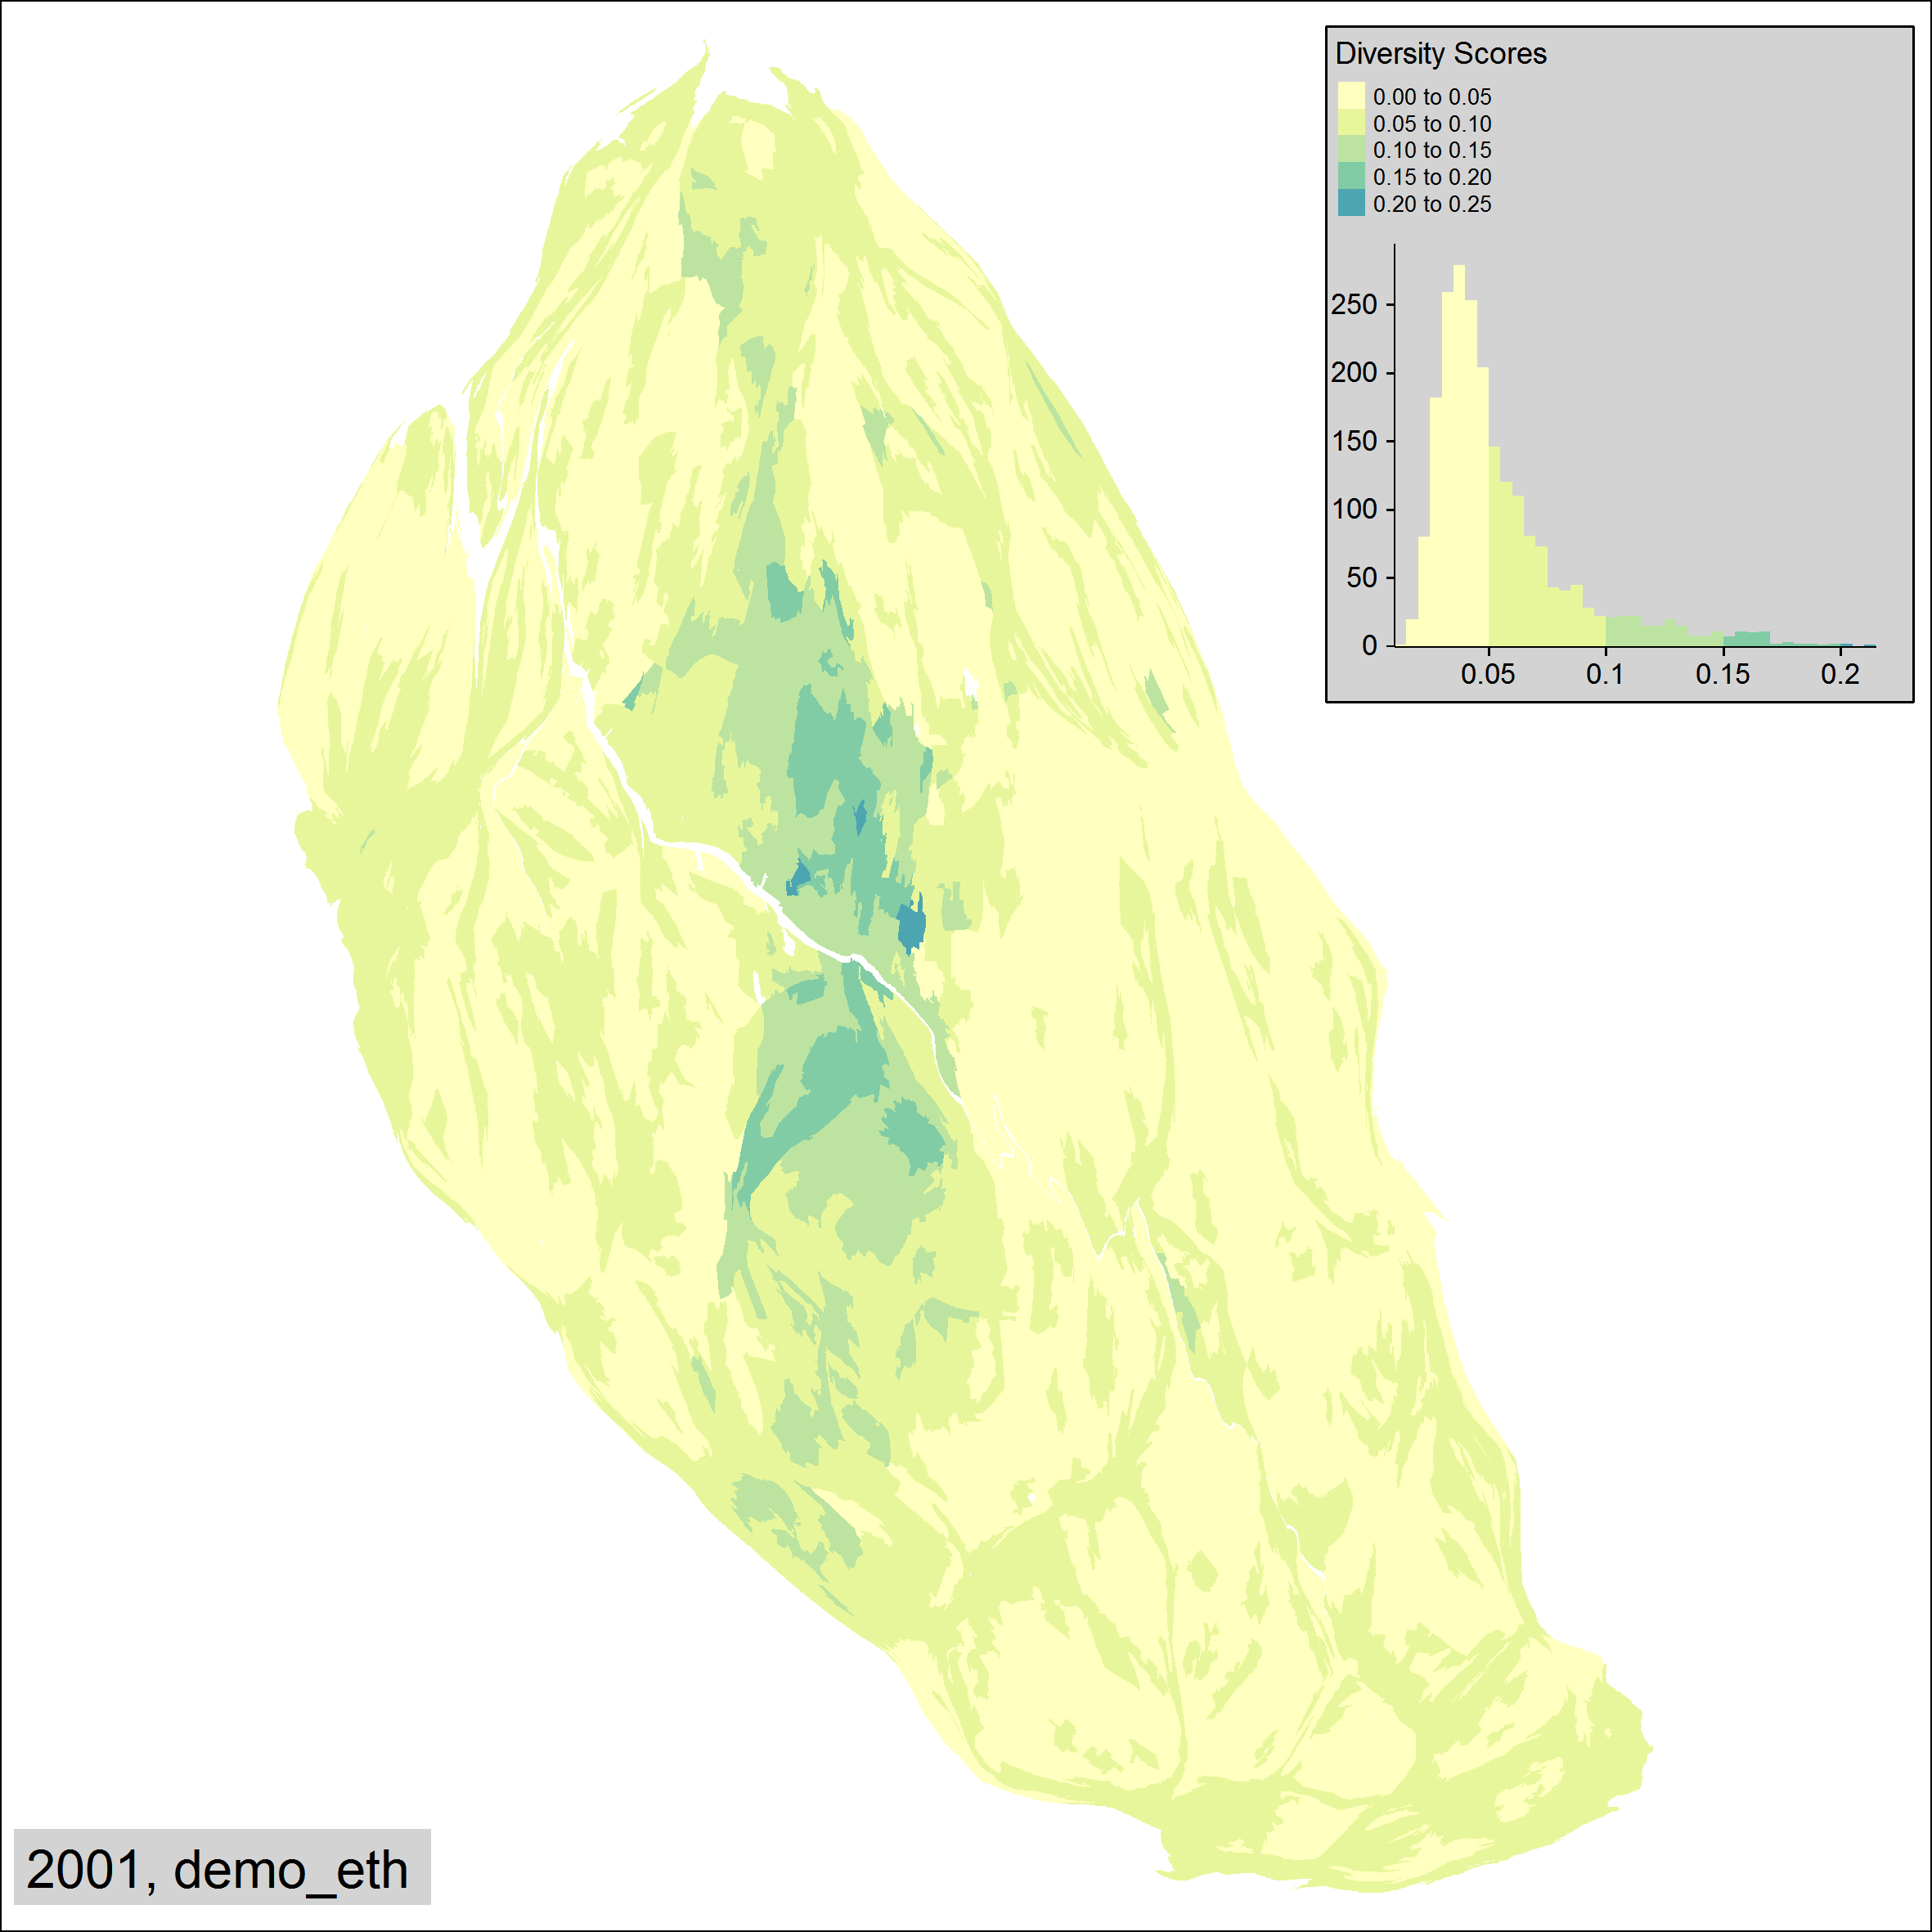
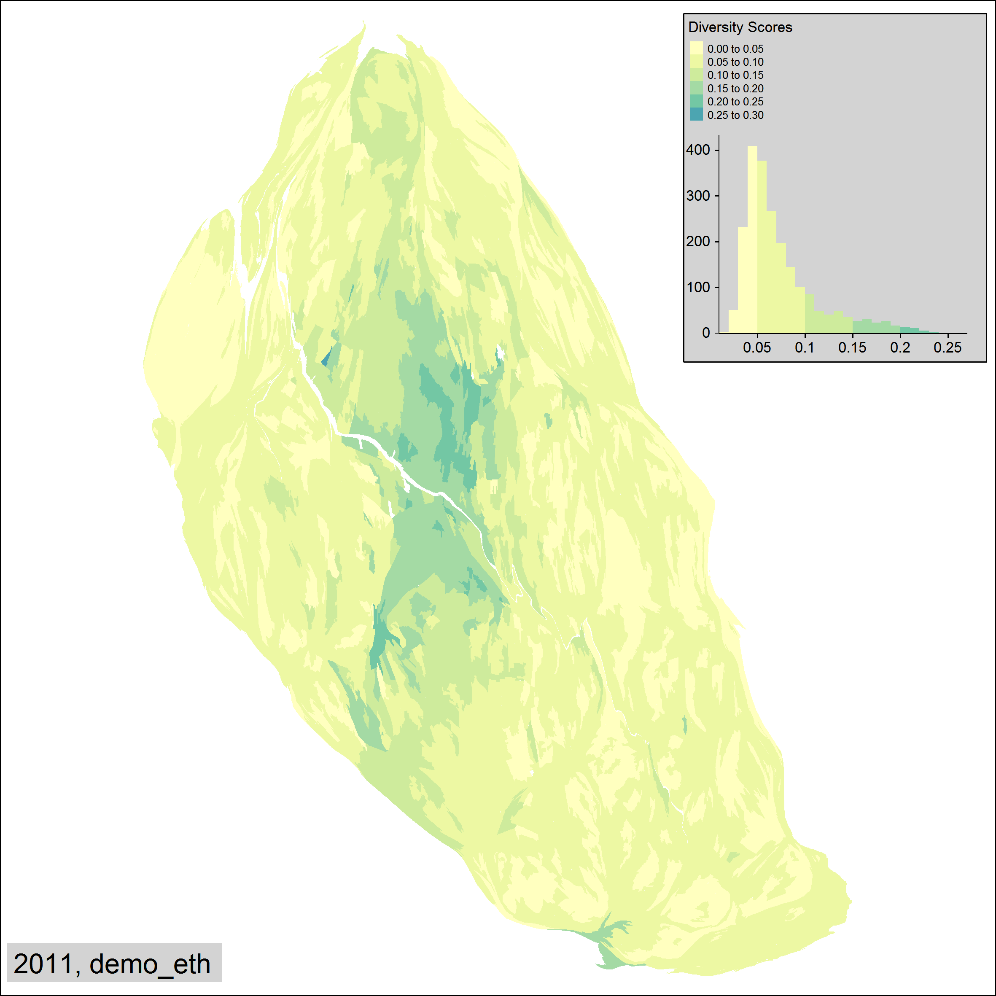
Selected maps
Building type, Ethnicity, Religion

Slide 25
Discussion
2001-2011 is a period of large scale demographic change in Scotland as elsewhere in UK
Cities are magnets for migration
Large increase in ethnic minority population and diversity in Glasgow
Large increase in tenure diversity (more renting?)
Greatest increases in ethnic diversity in areas with lowest housing stock diversity
Increasing population size through migration
Reduced average age, better average health, better qualified?

Slide 26
Discussion
Important density and distance nonlinearities
High density, high centrality -> high diversity of people
‘Kink’ around 6000 people/km²
Network effects/agglomeration economies?
Distance within 5-8km: different relationship
i.e. around 1 hr by foot/cycle/public transport
Jesse Ausubel
distance defined by time not space (‘20 minutes away’)
‘Fixed’ time-travel preference, regardless of mode of transport
Functional urban geographies
Community Health Partnerships?
Travel to work areas? (Dominated by car owners?)
Mode-specific TTWAs? (Distance/hour)
Amenity-specific TTWAs? (Mixed use & accessibility)

Slide 27
Next steps
Associations between diversity and:
Health (Walsh et al 2016)
Economic development
Demographic change (including fertility)
Educational outcomes
Happiness
‘Natural Experiments’
Effects of regeneration (GoWell)
Generalisability to other cities

Slide 28
Thanks for listening!
Analyses available from:
https://github.com/JonMinton/gowell
Diversity maps from:
https://github.com/JonMinton/gowell/tree/master/maps/diversities
Email: jonathan.Minton@Glasgow.ac.uk

